Slide 1
The Molecule That Supports All of Life
Water makes life possible on Earth
Water is the only common substance to exist in the natural environment in all three physical states of matter
Water’s unique emergent properties help make Earth suitable for life
The structure of the water molecule allows it to interact with other molecules

Slide 2
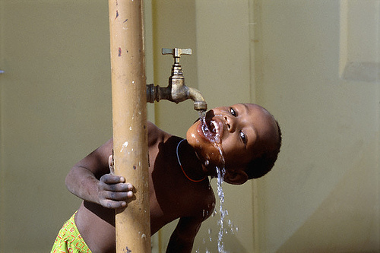
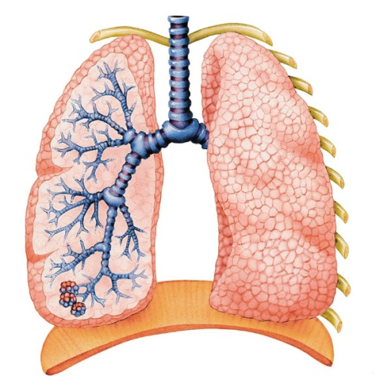
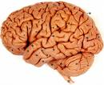
Water is essential to all life on Earth!
Water makes up about 70% of all living organisms on Earth (almost 90% of body weight!). This is some more evidence that life originated in water. Terrestrial organisms, like humans, have to carry their water with them.
Human brains are about 70% water.
Human lungs are nearly 90% water.
Human blood is about 83% water.
To remain alive, an adult human must replace 2.5 Liters of water/day. Much of this comes from foods that we eat. Humans’ sense of smell, taste and sight require water, and our alveoli, for gas exchange, always remain moist!

Slide 3
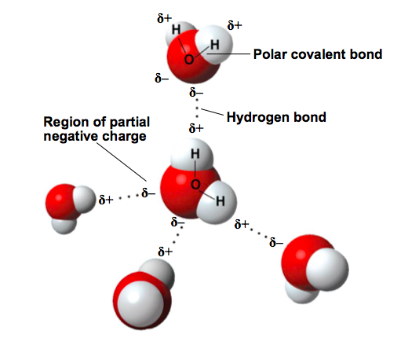
Properties of Water
the electrons of the polar covalent bonds spend more time near the oxygen than the hydrogen
  polar molecule: overall charge is unevenly distributed
Polarity allows water molecules to form hydrogen bonds with each other

Slide 4

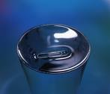
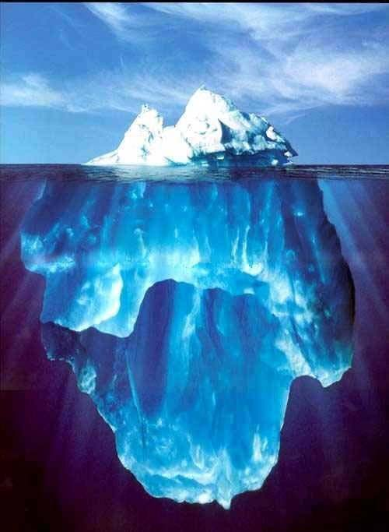
Properties of water
Cohesive behavior
Ability to moderate temperature
Expansion upon freezing - less dense as a solid than it is as a liquid – this is very rare on earth!
Versatility as a solvent
Water is “adhesive”

Slide 5
Cohesion of Water Molecules
the ability to bind to itself (surface tension)
Collectively, hydrogen bonds hold water molecules together, a phenomenon called cohesion
Cohesion helps the transport of water against gravity in plants
Adhesion is an attraction between different substances, for example, between water and plant cell walls

Slide 6
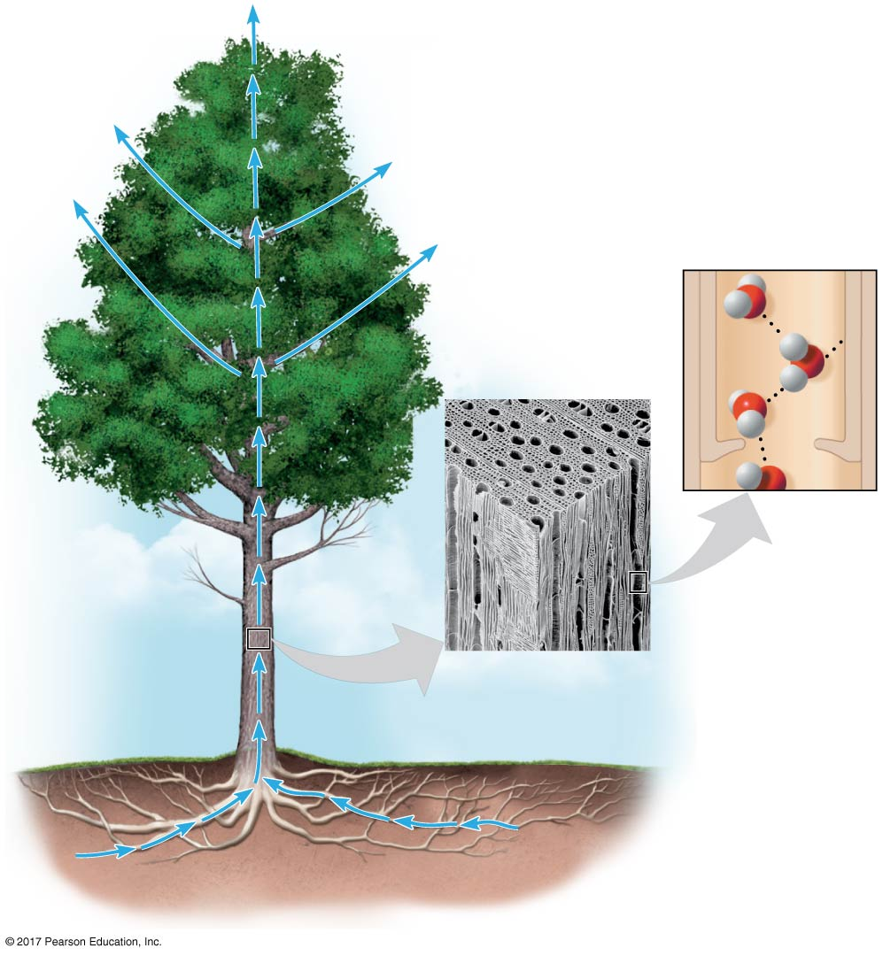
Figure 3.3
Evaporation pulls water upward.
H₂O
Adhesion
Two types of
water-conducting
cells
Direction
of water
movement
Cohesion
300 µm
H₂O
H₂O
Notes:
Figure 3.3 Water transport in plants

Slide 7
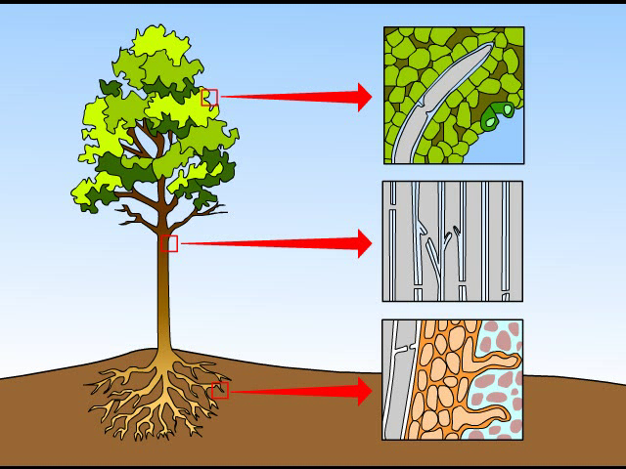
Animation: Water Transport in Plants

Slide 8
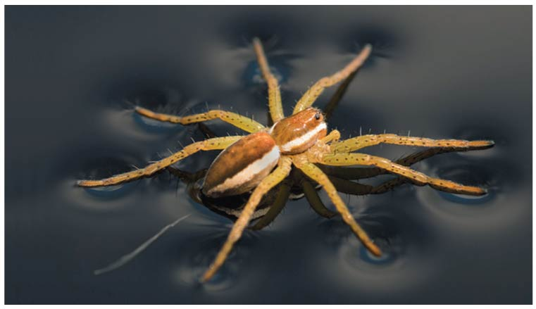
Surface tension is a measure of how difficult it is to break the surface of a liquid
Water has an unusually high surface tension due to hydrogen bonding between the molecules at the air-water interface and to the water below

Slide 9
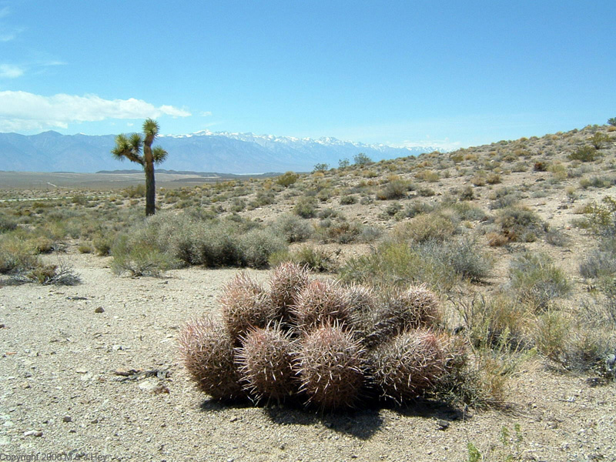

Moderation of Temperature by Water
Water can absorb or release a large amount of heat with only a slight change in its own temperature
H₂O resists changes in temperature
  high specific heat
  takes a lot to heat it up
  takes a lot to cool it down
H₂O moderates temperatures on Earth

Slide 10
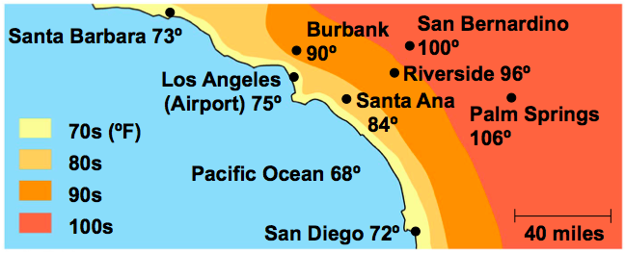
Water’s high specific heat can be traced to hydrogen bonding
  Heat is absorbed when hydrogen bonds break
  Heat is released when hydrogen bonds form
The high specific heat of water minimizes temperature fluctuations to within limits that
permit life

Slide 11

Evaporative Cooling
Vaporization= liquid→ gas
Heat of Vaporization= quantity of heat a liquid must absorb for 1 g to be converted to gaseous state(2260J/g)
Evaporative cooling = cooling of a liquid’s surface when the liquid evaporates
*as large # of molecules break free and depart, they carry away some energy and decrease water’s surface temp.
Water’s high heat of vaporization:
Moderates earth’s climate
Stabilizes temp. in aquatic ecosystems
Helps organisms from overheating by evaporative cooling

Slide 12
Evaporative Cooling
Evaporation (or vaporization) is transformation of a substance from liquid to gas
Heat of vaporization is the heat a liquid must absorb for 1 g to be converted to gas
As a liquid evaporates, its remaining surface cools, a process called evaporative cooling
Evaporative cooling of water helps stabilize temperatures in organisms and bodies of water

Slide 13
Floating of Ice on Liquid Water
Ice floats in liquid water because hydrogen bonds in ice are more “ordered,” making ice less dense than water
Water reaches its greatest density at 4ºC
If ice sank, all bodies of water would eventually freeze solid, making life impossible on Earth

Slide 14
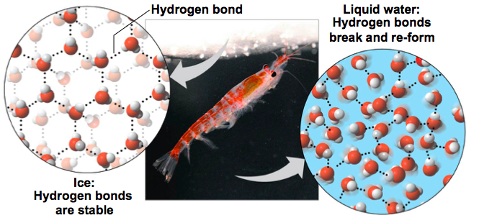
The special case of ice: Ice floats!!
Most substances are more dense when they are solid, but
Not water…it is most dense at degrees
  H bonds form a crystal and floats
If ice sank, all bodies of water would eventually freeze solid, making life impossible on Earth
4۫ C

Slide 15
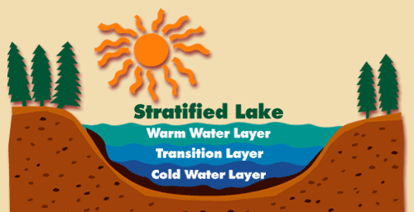
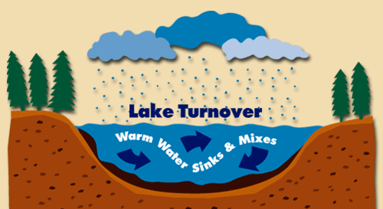
Why is “ice floats” important?
Oceans & lakes don’t freeze solid
  surface ice insulates water below
    allowing life to survive the winter
  if ice sank…
    ponds, lakes & even oceans would freeze solid
    in summer, only upper few inches would thaw
  seasonal turnover of lakes
    cycling nutrients in autumn

Slide 16
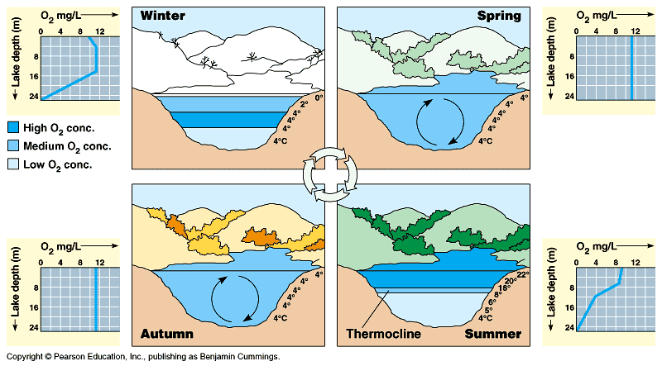

Slide 17
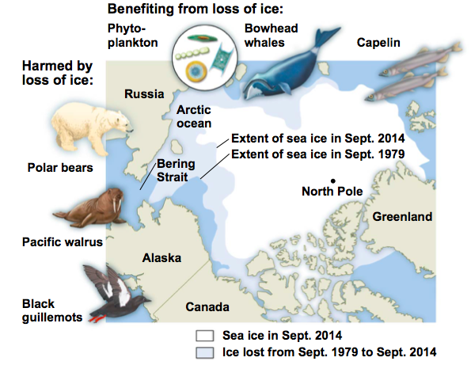
Many scientists are worried that global warming is having a profound effect on icy environments around the globe
  The rate poses an extreme challenge to animals that depend on ice for their survival

Slide 18
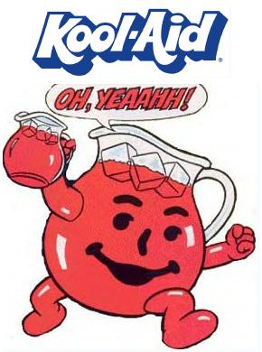
Universal Solvent “like dissolves like”
Solution = a liquid that is a homogeneous mixture of 2 or more substances
Solvent = Dissolving agent of the solution
Solute = Substance dissolved in the solution
Aqueous = Solution in which water is the solvent
Water is a medium for the chemical reactions of life~ METABOLISM

Slide 19
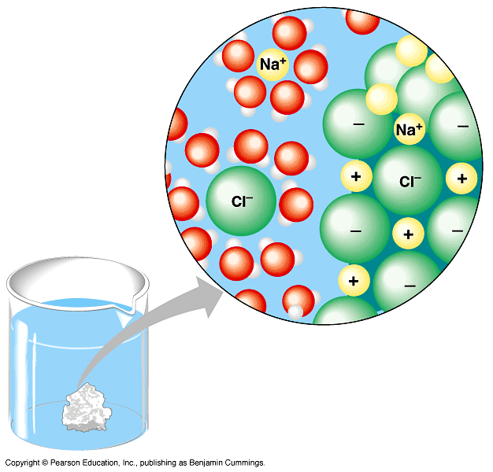
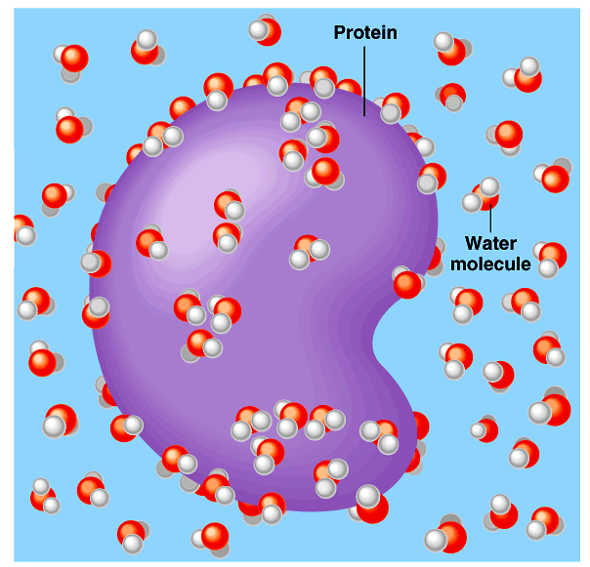
Water is the solvent of life
Polarity makes H₂O a good solvent
  polar H₂O molecules surround + & – ions
  solvents dissolve solutes creating solutions
Notes:
What dissolves in water easily?
polar or non-polar molecules?
How about Oxygen? Does that dissolve in H₂O?

Slide 20
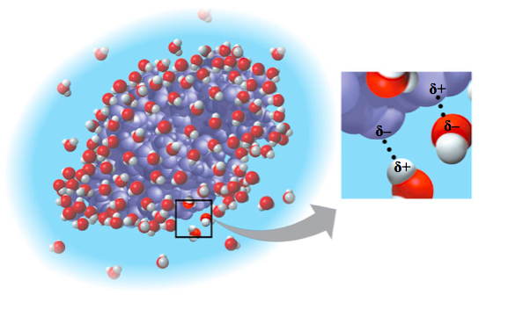
Water can also dissolve compounds made of nonionic polar molecules
Even large polar molecules such as proteins
can dissolve in water if they have ionic and
polar regions

Slide 21
Hydrophilic and Hydrophobic Substances
A hydrophilic substance is one that has an
affinity for water
A hydrophobic substance is one that does not have an affinity for water
Oil molecules are hydrophobic because they
have relatively nonpolar bonds
Hydrophobic molecules related to oils are the major ingredients of cell membranes

Slide 22
Acids and bases
A hydrogen atom in a hydrogen bond between two water molecules can shift from one to the other
  The hydrogen atom leaves its electron behind and is transferred as a proton, or hydrogen ion (H⁺)
  The molecule that lost the proton is now a hydroxide ion (OH–)
  The molecule with the extra proton is now a hydronium ion (H₃O⁺), though it is often represented as H⁺

Slide 23
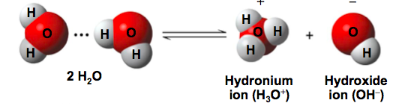
Water is in a state of dynamic equilibrium in which water molecules dissociate at the same rate at which they are being reformed

Slide 24
Though statistically rare, the dissociation of water molecules has a great effect on organisms
Changes in concentrations of H⁺ and OH– can drastically affect the chemistry of a cell
Concentrations of H⁺ and OH– are equal in
pure water
Adding certain solutes, called acids and bases, modifies the concentrations of H⁺ and OH–
Biologists use the pH scale to describe whether a solution is acidic or basic (the opposite of acidic)

Slide 25
Acids and Bases
An acid is a substance that increases the H⁺ concentration of a solution
A base is a substance that reduces the H⁺ concentration of a solution
Strong acids and bases dissociate completely
in water
Weak acids and bases reversibly release and accept back hydrogen ions, but can still shift the balance of H⁺ and OH– away from neutrality

Slide 26
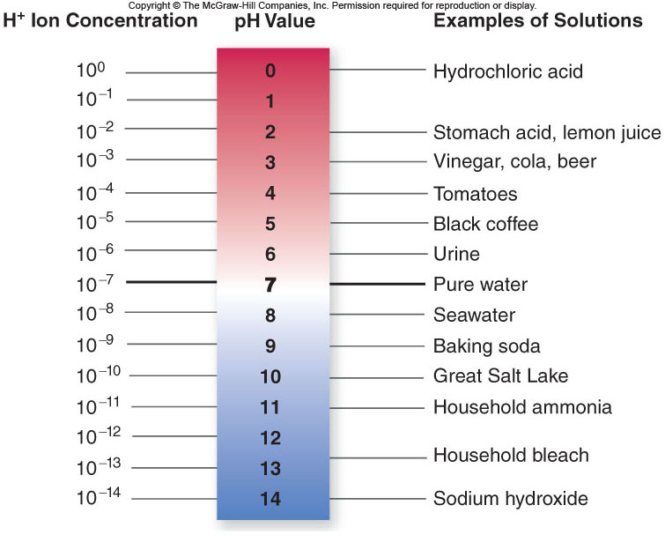
Acids and Bases

Slide 27
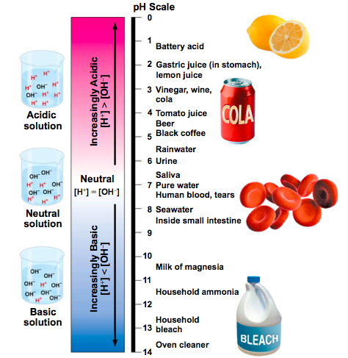
Acidic = pH values less than 7
Basic = values greater than 7
Most biological fluids have pH values in the range of 6 to 8

Slide 28
Acids and Bases
Acid: a chemical that releases H⁺¹ ions.
Base: a chemical that accepts H⁺¹ ions.
Buffer: a chemical that accepts/releases H⁺¹ as necessary to keep pH constant

Slide 29
Buffers
The internal pH of most living cells is close to 7
Buffers are substances that minimize changes in concentrations of H⁺ and OH– in a solution
Most buffer solutions contain a weak acid and its corresponding base, which combine reversibly with H⁺ ions

Slide 30

Buffers in the BLOOD!
If your blood has been depleted of water causing a rise in pH (more hydroxide ions) of blood from normal 7.4 How does equilibrium respond knowing a person cannot survive a shift in blood pH of more than 10-fold?
More carbonic acid dissociates resulting in more H⁺ (producing more water when it joins with the excess OH⁻)

Slide 31
Acidification: A Threat to Our Oceans
Human activities such as burning fossil fuels threaten water quality
CO₂ is the main product of fossil fuel combustion
About 25% of human-generated CO₂ is absorbed by the oceans
CO₂ dissolved in seawater forms carbonic acid H₂CO₃; this process is called ocean acidification

Slide 32
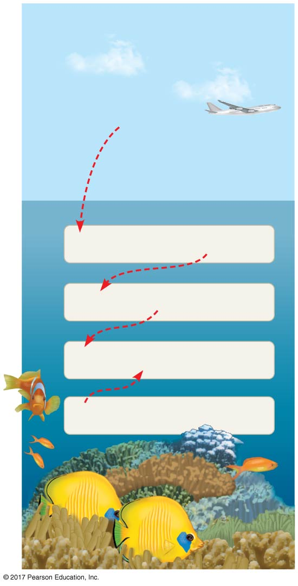
Figure 3.12
As seawater acidifies, H⁺ ions combine with carbonate ions to produce bicarbonate HCO₃
Carbonate is required for calcification (production of calcium carbonate) by many marine organisms, including reef-building corals
We have made progress in learning about the delicate chemical balances in oceans, lakes,
and rivers
CO₂
CO₂ + H₂O
H₂CO₃
H₂CO₃
H⁺ + HCO₃–
H⁺ + CO₃^{2–}
HCO₃–
CO₃^{2–} + Ca²⁺
CaCO₃
Notes:
Figure 3.12 Atmospheric CO₂ from human activities and its fate in the ocean

Slide 33
As seawater acidifies, H⁺ ions combine with carbonate ions to produce bicarbonate HCO₃
Carbonate is required for calcification (production of calcium carbonate) by many marine organisms, including reef-building corals
We have made progress in learning about the delicate chemical balances in oceans, lakes,
and rivers

